Slide 1
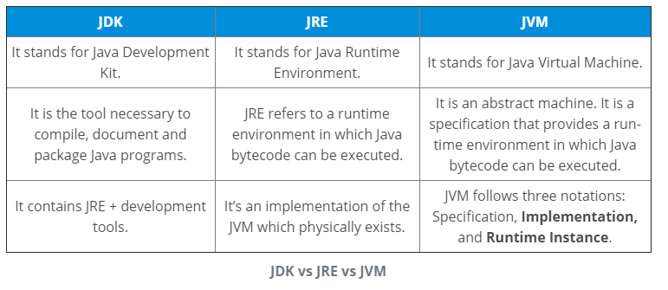
Exercise 1:
Explain JDK, JRE and JVM?
Why Java is platform independent?
Java is called platform independent because of its byte codes which can run on any system irrespective of its underlying operating system.

Slide 2
3. Why pointers are not used in Java?
Java doesn’t use pointers because they are unsafe and increases the complexity of the program. Since, Java is known for its simplicity of code, adding the concept of pointers will be contradicting. Moreover, since JVM is responsible for implicit memory allocation, thus in order to avoid direct access to memory by the user, pointers are discouraged in Java.
4. What is JIT compiler in Java?
JIT stands for Just-In-Time compiler in Java. It is a program that helps in converting the Java bytecode into instructions that are sent directly to the processor. By default, the JIT compiler is enabled in Java and is activated whenever a Java method is invoked. The JIT compiler then compiles the bytecode of the invoked method into native machine code, compiling it “just in time” to execute. Once the method has been compiled, the JVM summons the compiled code of that method directly rather than interpreting it. This is why it is often responsible for the performance optimization of Java applications at the run time.

Slide 3
5. What do you know about Java?
Java is a high-level programming language originally developed by Sun
Microsystems and released in 1995. Java runs on a variety of platforms, such as
Windows, Mac OS, and the various versions of UNIX.
6. What are the supported platforms by Java Programming Language?
Java runs on a variety of platforms, such as Windows, Mac OS, and the various
versions of UNIX/Linux like HP-Unix, Sun Solaris, Redhat Linux, Ubuntu, CentOS, etc.

Slide 4
7. How Java enabled High Performance?
A: Java uses Just-In-Time compilerto enable high performance. Just-In-Time compiler
is a program that turns Java bytecode, which is a program that contains instructions
that must be interpreted into instructions that can be sent directly to the processor
8. What is Java Virtual Machine and how it is considered in context of Java’s platform independent feature?
A: When Java is compiled, it is not compiled into platform specific machine, rather
into platform independent byte code. This byte code is distributed over the web and
interpreted by virtual Machine (JVM) on whichever platform it is being run.

Slide 5
9. List two Java IDE’s?
A: Netbeans, Eclipse, etc.
10. What is the Difference between JDK and JRE ?
The Java Runtime Environment (JRE) is basically the Java Virtual Machine (JVM) where your Java programs are being executed.
It also includes browser plugins for applet execution. The Java Development Kit (JDK) is the full featured Software Development
Kit for Java, including the JRE, the compilers and tools (like JavaDoc, and Java Debugger), in order for a user to develop, compile
and execute Java applications.

Slide 6
11. Why people say that Java is 'write once and run anywhere' language?
You can write Java code on Windows and compile it in Windows
platform. The class and jar files that you get from Windows
platform can run as it is on Unix environment. So it is a truly
platform independent language.
Behind all this portability is Java byte code. Byte code generated by
Java compiler can be interpreted by any JVM. So it becomes much
easier to write programs in Java and expect those to run on any
platform.
Java compiler javac compiles java code and JVM java runs that
code.

Slide 7
12. Insert the missing part of the code below to output "Hello World".
public class MyClass {
public static void main(String[] args) {
. . ("Hello World");
}
}
13.Comments in Java are written with special characters. Insert the missing parts:
This is a single-line comment
This is a multi-line comment

Slide 8
14. Write a Java program to print 'Hello' on screen and then print your name on a separate line.
Expected Output:
Hello
Alexandra Abramov
15. Write a Java program to print the sum of two numbers.
Test Data:
74 + 36
Expected Output :
110
16. Write a Java program to divide two numbers and print on the screen.
Test Data :
50/3
Expected Output :
16

Slide 9
17. Write a Java program to print the result of the following operations. Go to the editor
Test Data:
a. -5 + 8 * 6
b. (55+9) % 9
c. 20 + -3*5 / 8
d. 5 + 15 / 3 * 2 - 8 % 3
Expected Output :
43
1
19
13

Slide 10
public class Exercise4
{
public static void main(String[] args)
{
System.out.println(-5 + 8 * 6);
System.out.println((55+9) % 9);
System.out.println(20 + -3*5 / 8);
System.out.println(5 + 15 / 3 * 2 - 8 % 3);
}
}

Slide 11
public class Main
{
public static void main(String[] args)
{
int w = -5 + 8 * 6;
int x = (55 + 9) % 9;
int y = 20 + (-3 * 5 / 8);
int z = 5 + 15 / 3 * 2 - 8 % 3;
System.out.print(w + "\n" + x + "\n" + y + "\n" + z);
}
}

Slide 12
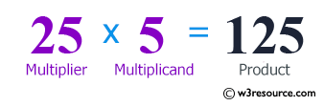
18. Write a Java program that takes two numbers as input and display the product of two numbers.
Test Data:
Input first number: 25
Input second number: 5

Slide 13
import java.util.Scanner;
public class Exercise5 {
public static void main(String[] args) {
Scanner in = new Scanner(System.in);
System.out.print("Input first number: ");
int num1 = in.nextInt();
System.out.print("Input second number: ");
int num2 = in.nextInt();
System.out.println(num1 + " x " + num2 + " = " + num1 * num2);
}
}

Slide 14
public class Main
{
static int x = 25;
static int y = 5;
public static void main(String[] args)
{
System.out.println(x*y);
}
}

Slide 15
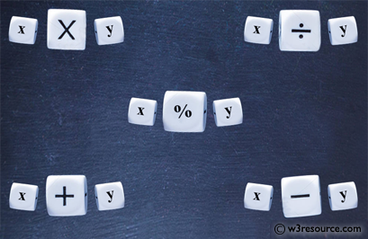
19. Write a Java program to print the sum (addition), multiply, subtract, divide and remainder of two numbers. Go to the editor
Test Data:
Input first number: 125
Input second number: 24
Expected Output :
125 + 24 = 149
125 - 24 = 101
125 x 24 = 3000
125 / 24 = 5
125 mod 24 = 5

Slide 16
import java.util.Scanner;
public class Exercise6 {
public static void main(String[] args) {
Scanner in = new Scanner(System.in);
System.out.print("Input first number: ");
int num1 = in.nextInt();
System.out.print("Input second number: ");
int num2 = in.nextInt();

Slide 17
System.out.println(num1 + " + " + num2 + " = " +
(num1 + num2));
System.out.println(num1 + " - " + num2 + " = " +
(num1 - num2));
System.out.println(num1 + " x " + num2 + " = " +
(num1 * num2));
System.out.println(num1 + " / " + num2 + " = " +
(num1 / num2));
System.out.println(num1 + " mod " + num2 + " = " +
(num1 % num2));
}
}

Slide 18
import java.util.Scanner;
public class Main {
public static void main(String[] args) {
Scanner scanner = new Scanner(System.in);
System.out.println("Input the first number: ");
int n1 = scanner.nextInt();
System.out.println("Input the second number: ");
int n2 = scanner.nextInt();
int sum = n1 + n2;
int minus = n1 - n2;
int multiply = n1 * n2;
int subtract = n1 + n2;
int divide = n1 / n2;
int rnums = n1 % n2;
System.out.printf("Sum = %d\nMinus = %d\nMultiply = %d\nSubtract = %d\nDivide = %d\nRemainderOf2Numbers = %d\n ", sum, minus, multiply, subtract, divide, rnums);
}
}

Slide 19
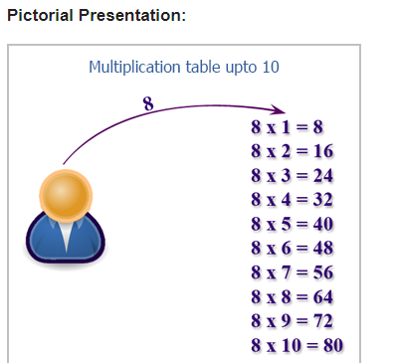
20. Write a Java program that takes a number as input and prints its multiplication table upto 10.
Test Data:
Input a number: 8

Slide 20
import java.util.Scanner;
public class Exercise7 {
public static void main(String[] args) {
Scanner in = new Scanner(System.in);
System.out.print("Input a number: ");
int num1 = in.nextInt();
for (int i=0; i< 10; i++){
System.out.println(num1 + " x " + (i+1) + " = " +
(num1 * (i+1)));
}
}
}

Slide 21
import java.util.Scanner;
public class Main {
public static void main(String[] args) {
Scanner in = new Scanner(System.in);
System.out.println("Input the Number: ");
int n = in .nextInt();
for (int i = 1; i <= 10; i++) {
System.out.println(n + "*" + i + " = " + (n * i));
}
}
}

Slide 22
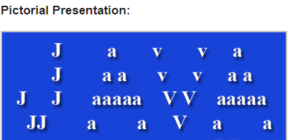
21. Write a Java program to display the following pattern.
public class Exercise8 {
public static void main(String[] args) {
System.out.println(" J a v v a ");
System.out.println(" J a a v v a a");
System.out.println("J J aaaaa V V aaaaa");
System.out.println(" JJ a a V a a");
}
}

Slide 23
22.Write a Java program to print the area and perimeter of a circle.
In geometry, the area enclosed by a circle of radius r is πr2. Here the Greek letter π represents a constant, approximately equal to 3.14159, which is equal to the ratio of the circumference of any circle to its diameter.
The circumference of a circle is the linear distance around its edge.

Slide 24
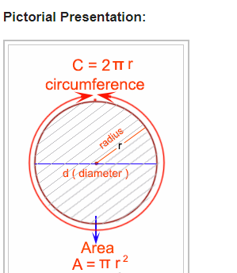
Open this below picture in slide mode to see the animation

Slide 25
public class Exercise11 {
private static final double radius = 7.5;
public static void main(String[] args) {
double perimeter = 2 * Math.PI * radius;
double area = Math.PI * radius * radius;
System.out.println("Perimeter is = " + perimeter);
System.out.println("Area is = " + area);
}
}

Slide 26
import java.util.Scanner;
public class Main {
public static void main(String[] args) {
Scanner io = new Scanner(System.in);
System.out.println("Input the radius of the circle: ");
double radius = io.nextDouble();
System.out.println("Perimeter is = " + (2 * radius * Math.PI));
System.out.println("Area is = " + (Math.PI * radius * radius));
}
}

Slide 27
Write a Java program to swap two variables.
Java: Swapping two variables
Swapping two variables refers to mutually exchanging the values of the variables. Generally, this is done with the data in memory.
The simplest method to swap two variables is to use a third temporary variable :
define swap(a, b)
temp := a
a := b
b := temp

Slide 28
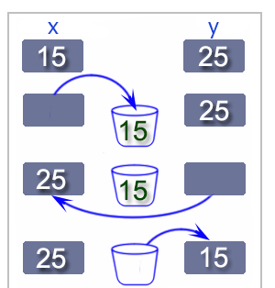

Slide 29
public class Exercise15 {
public static void main(String[] args) {
int a, b, temp;
a = 15;
b = 27;
System.out.println("Before swapping : a, b = "+a+", "+ + b);
temp = a;
a = b;
b = temp;
System.out.println("After swapping : a, b = "+a+", "+ + b);
}
}

Slide 30
Without using third variable.
Sample Solution:-
Java Code:
public class Exercise15 {
public static void main(String[] args) {
// int, double, float
int a, b;
a = 15;
b = 27;
System.out.println("Before swapping : a, b = "+a+", "+ + b);
a = a + b;
b = a - b;
a = a - b;
System.out.println("After swapping : a, b = "+a+", "+ + b);
}
}

Slide 31
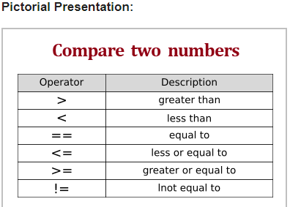
Write a Java program to compare two numbers.
Test Data:
Input first integer: 25
Input second integer: 39

Slide 32
import java.util.Scanner;
public class Exercise32 {
public static void main( String args[] )
{
// create Scanner to obtain input from command window
Scanner input = new Scanner(System.in);
int number1; // first number to compare
int number2; // second number to compare
System.out.print( "Input first integer: " ); // prompt
number1 = input.nextInt(); // read first number from user
System.out.print( "Input second integer: " ); // prompt
number2 = input.nextInt(); // read second number from user

Slide 33
if ( number1 == number2 )
System.out.printf( "%d == %d\n", number1, number2 );
if ( number1 != number2 )
System.out.printf( "%d != %d\n", number1, number2 );
if ( number1 < number2 )
System.out.printf( "%d < %d\n", number1, number2 );
if ( number1 > number2 )
System.out.printf( "%d > %d\n", number1, number2 );
if ( number1 <= number2 )
System.out.printf( "%d <= %d\n", number1, number2 );
if ( number1 >= number2 )
System.out.printf( "%d >= %d\n", number1, number2 );
}
}

Slide 34
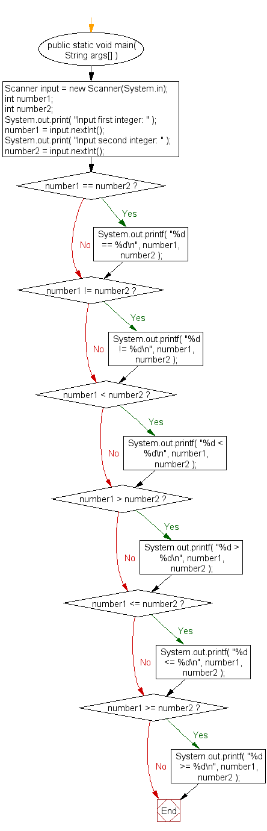
Flowchart:

Slide 35
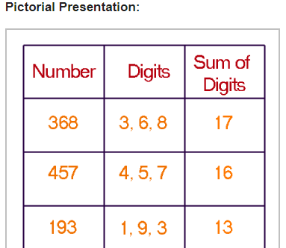
Write a Java program and compute the sum of the digits of an integer.
Test Data:
Input an intger: 25

Slide 36
import java.util.Scanner;
public class Exercise33 {
public static void main(String[] args) {
Scanner input = new Scanner(System.in);
System.out.print("Input an integer: ");
long n = input.nextLong();
System.out.println("The sum of the digits is: " + sumDigits(n));
}
public static int sumDigits(long n) {
int sum = 0;
while (n != 0) {
sum += n % 10;
n /= 10;
}
return sum;
}
}

Slide 37
1. Which one is executing only time in for loop?
A> Initialization C> Boolean condition
B> Increment/decrement D>body
2. Which one is executing before every iteration in the loop?
A> Initialization C> Boolean condition
B> Increment/decrement D>body
3. Which one is executing last statement ?
A> Initialization C> Boolean condition
B> Increment/decrement D>body
4. Which one executing from 2nd iteration onwards in the for-loop
A> Initialization C> Boolean condition
B> Increment/decrement D>body

Slide 38
5. Is it possible to declare initialization portion before for loop
A> Yes B> No
6. Is it possible to declare and initialize multiple variable of same data type in the for initialization portion?
A> Yes B> No
7. Which is true for do while loop
A> First it checks Boolean condition then execute code
B> First execute the code then checks Boolean condition
8. The purpose of using loop is
A> To repeat operation many times B> make a decision
9. Which keyword is used to come away from the for-loop?
A> Break B> Continue C> Default

Slide 39
10. Is it possible to keep for-loop initialization portion as blank?
A> Yes B> No
11. Is it possible to keep for-loop Boolean condition portion as blank?
B> Yes B> No
12. Is it possible to keep for-loop increment/decrement portion as blank?
A> Yes B> No
13. In && operator if first condition is false
A> It will check second condition also
B> No need to check second condition
14. In && operator if first condition is true
A> It will check second condition also
B> No need to check second condition

Slide 40
15. In || operator if first condition is true
A> It will check second condition also
B> No need to check second condition
16. In || operator if first condition is false
A> It will check second condition also
B> No need to check second condition
17. In for loop initial value should Confirmed with Boolean condition.
A> True B> False
18. Continue keyword should be
A> First statement in the current block
B> Last statement in the current block
19. In do-while loop at any condition minimum one condition will execute
A> True B> False
20. Do-while loop always it should end with
A> , (comma) B>_ (underscore) C> : (colon) D>; (semicolon)

Slide 41
21. Increment/decrement section will executes from first iteration onwards
A> True B> False
22. Boolean condition executes for every iteration including first iteration also
A> False B> True
23. Which one is a separator in case of enhanced for loop
A> ; B> : C> ,(comma) D> _ (underscore)
24. Even though Boolean condition is false
A> Do-while body will executes one time
B> Do-while body will not executes
25. Whenever continue executes then it will skip remaining portion.
A> False B> True
26. Break keyword always should be first statement in the current block.
A> True B> False

Slide 42
1 A
2 C
3 C
4 B
5 A
6 A
7 B
8 A
9 A
10 A
11 B
12 A
13 B
14 A
15 B
16 A
17 A
18 B
19 A
20 D
21 B
22 B
23 B
24 A
25 B
26 B

Slide 43
How many keywords are there in JDK8 and what are those?
1.
whcih command is used to set env variable in the command prompt?
A.
echo
B.
path
C.
classpath
D.
set

Slide 44
2.
How many ways are there to set path env variableQ6
A.
1
B.
2
C.
3
D.
0

Slide 45
3.
which way of setting a path will be local to the current command prompt?Q7
A.
through set command
B.
in my computer under user level
C.
in my computer under system level
D.
none of the above

Slide 46
4.
which way of setting a path will be to every user??Q9
A.
through set command
B.
in my computer under user level
C.
in my computer under system level
D.
none of the above

Slide 47
5.
how to know the version of JDK?Q11
A.
javac -version
B.
javac version
C.
JDK -version
D.
JDK version

Slide 48
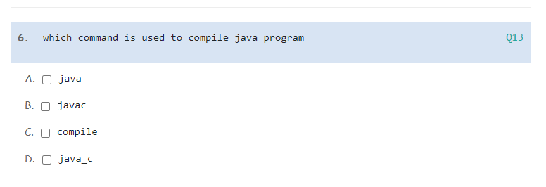
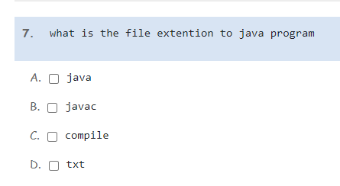

Slide 49
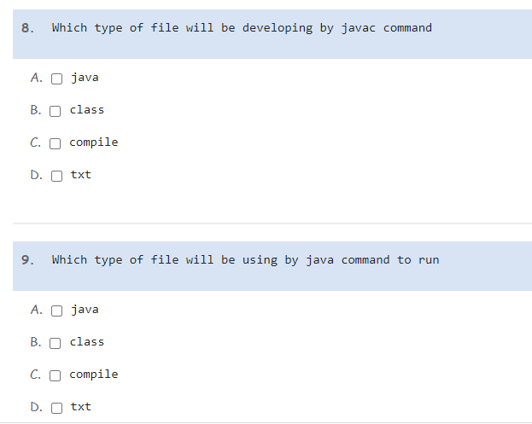

Slide 50
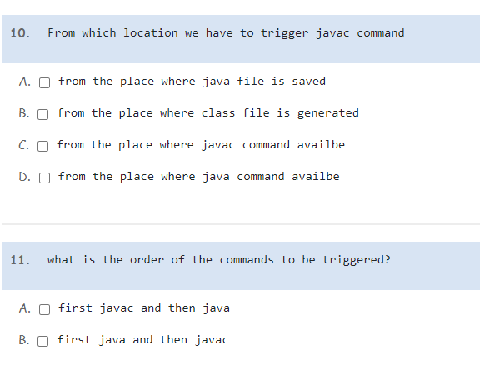

Slide 51
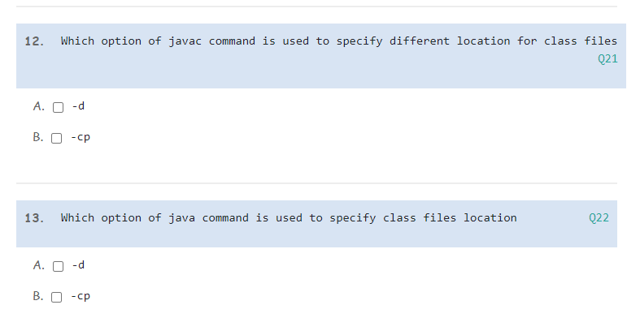

Slide 52
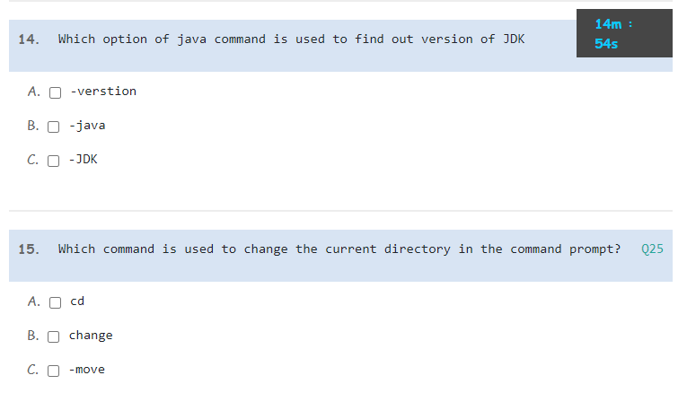

Slide 53
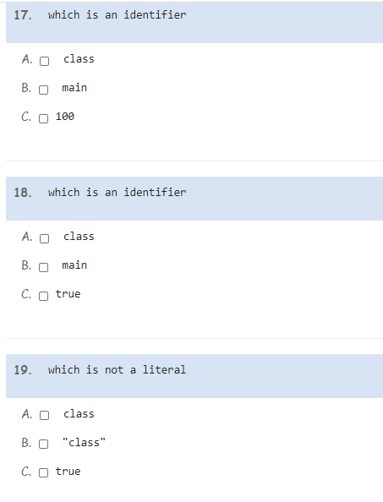

Slide 54
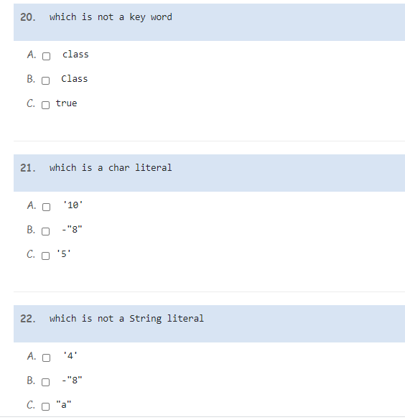

Slide 55
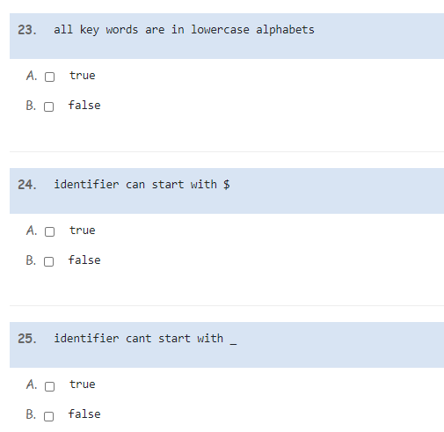

Slide 56
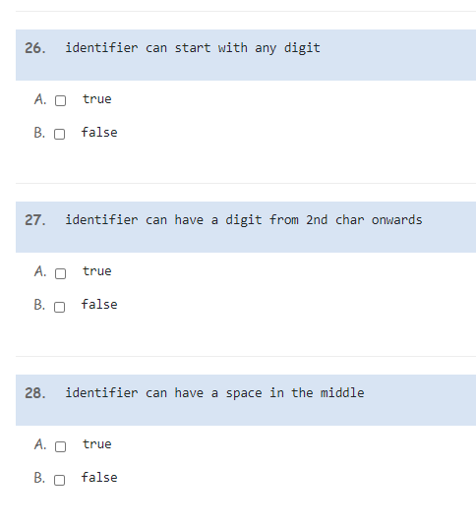

Slide 57
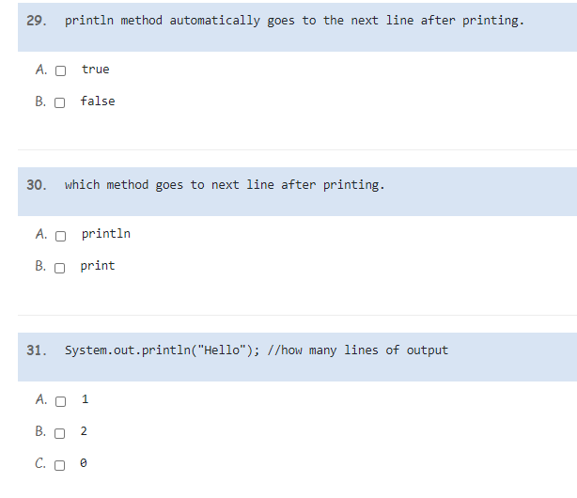

Slide 58
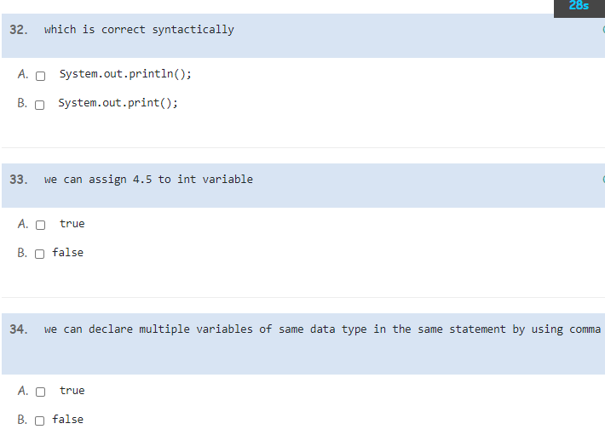

Slide 59
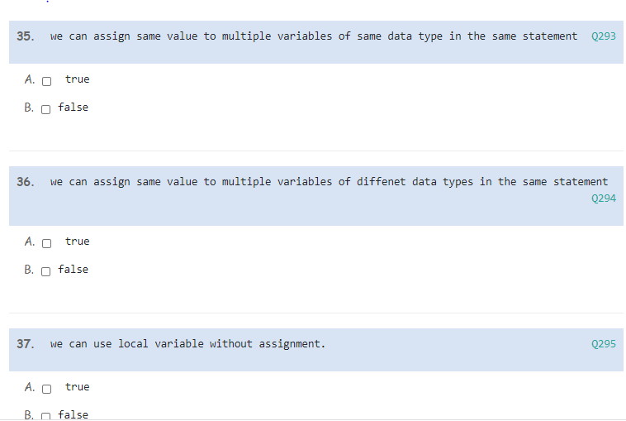

Slide 60
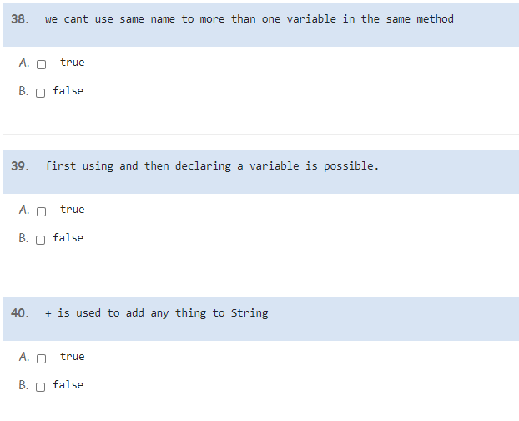

Slide 61
Problem
The parameter weekday is true if it is a weekday, and the parameter vacation is true if we are on vacation. We sleep in if it is not a weekday or we're on vacation. Return true if we sleep in.
sleepIn(false, false) → true
sleepIn(true, false) → false
sleepIn(false, true) → true

Slide 62
Solution:
public boolean sleepIn(boolean weekday, boolean vacation) {
if (!weekday || vacation) {
return true;
}
return false;
// Solution notes: better to write "vacation" than "vacation == true"
// though they mean exactly the same thing.
// Likewise "!weekday" is better than "weekday == false".
// This all can be shortened to: return (!weekday || vacation);
// Here we just put the return-false last, or could use an if/else.
}

Slide 63
Problem
We have two monkeys, a and b, and the parameters aSmile and bSmile indicate if each is smiling. We are in trouble if they are both smiling or if neither of them is smiling. Return true if we are in trouble.
monkeyTrouble(true, true) → true
monkeyTrouble(false, false) → true
monkeyTrouble(true, false) → false

Slide 64
Solution:
public boolean monkeyTrouble(boolean aSmile, boolean bSmile) {
if (aSmile && bSmile) {
return true;
}
if (!aSmile && !bSmile) {
return true;
}
return false;
// The above can be shortened to:
// return ((aSmile && bSmile) || (!aSmile && !bSmile));
// Or this very short version (think about how this is the same as the above)
// return (aSmile == bSmile);
}

Slide 65
Given two int values, return their sum. Unless the two values are the same, then return double their sum.
sumDouble(1, 2) → 3
sumDouble(3, 2) → 5
sumDouble(2, 2) → 8

Slide 66
Solution:
public int sumDouble(int a, int b) {
// Store the sum in a local variable
int sum = a + b;
// Double it if a and b are the same
if (a == b) {
sum = sum * 2;
}
return sum;
}

Slide 67
Given an int n, return the absolute difference between n and 21, except return double the absolute difference if n is over 21.
diff21(19) → 2
diff21(10) → 11
diff21(21) → 0
Solution:
public int diff21(int n) {
if (n <= 21) {
return 21 - n;
} else {
return (n - 21) * 2;
}
}

Slide 68
We have a loud talking parrot. The "hour" parameter is the current hour time in the range 0..23. We are in trouble if the parrot is talking and the hour is before 7 or after 20. Return true if we are in trouble.
parrotTrouble(true, 6) → true
parrotTrouble(true, 7) → false
parrotTrouble(false, 6) → false
Solution:
public boolean parrotTrouble(boolean talking, int hour) {
return (talking && (hour < 7 || hour > 20));
// Need extra parenthesis around the || clause
// since && binds more tightly than ||
// && is like arithmetic *, || is like arithmetic +
}

Slide 69
Given 2 ints, a and b, return true if one if them is 10 or if their sum is 10.
makes10(9, 10) → true
makes10(9, 9) → false
makes10(1, 9) → true
Solution:
public boolean makes10(int a, int b) {
return (a == 10 || b == 10 || a+b == 10);
}

